Slide 1

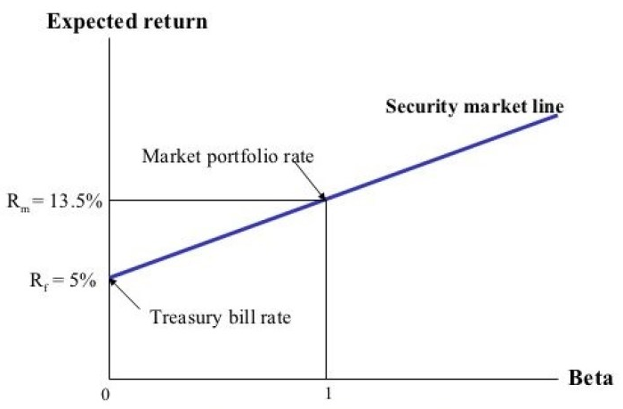
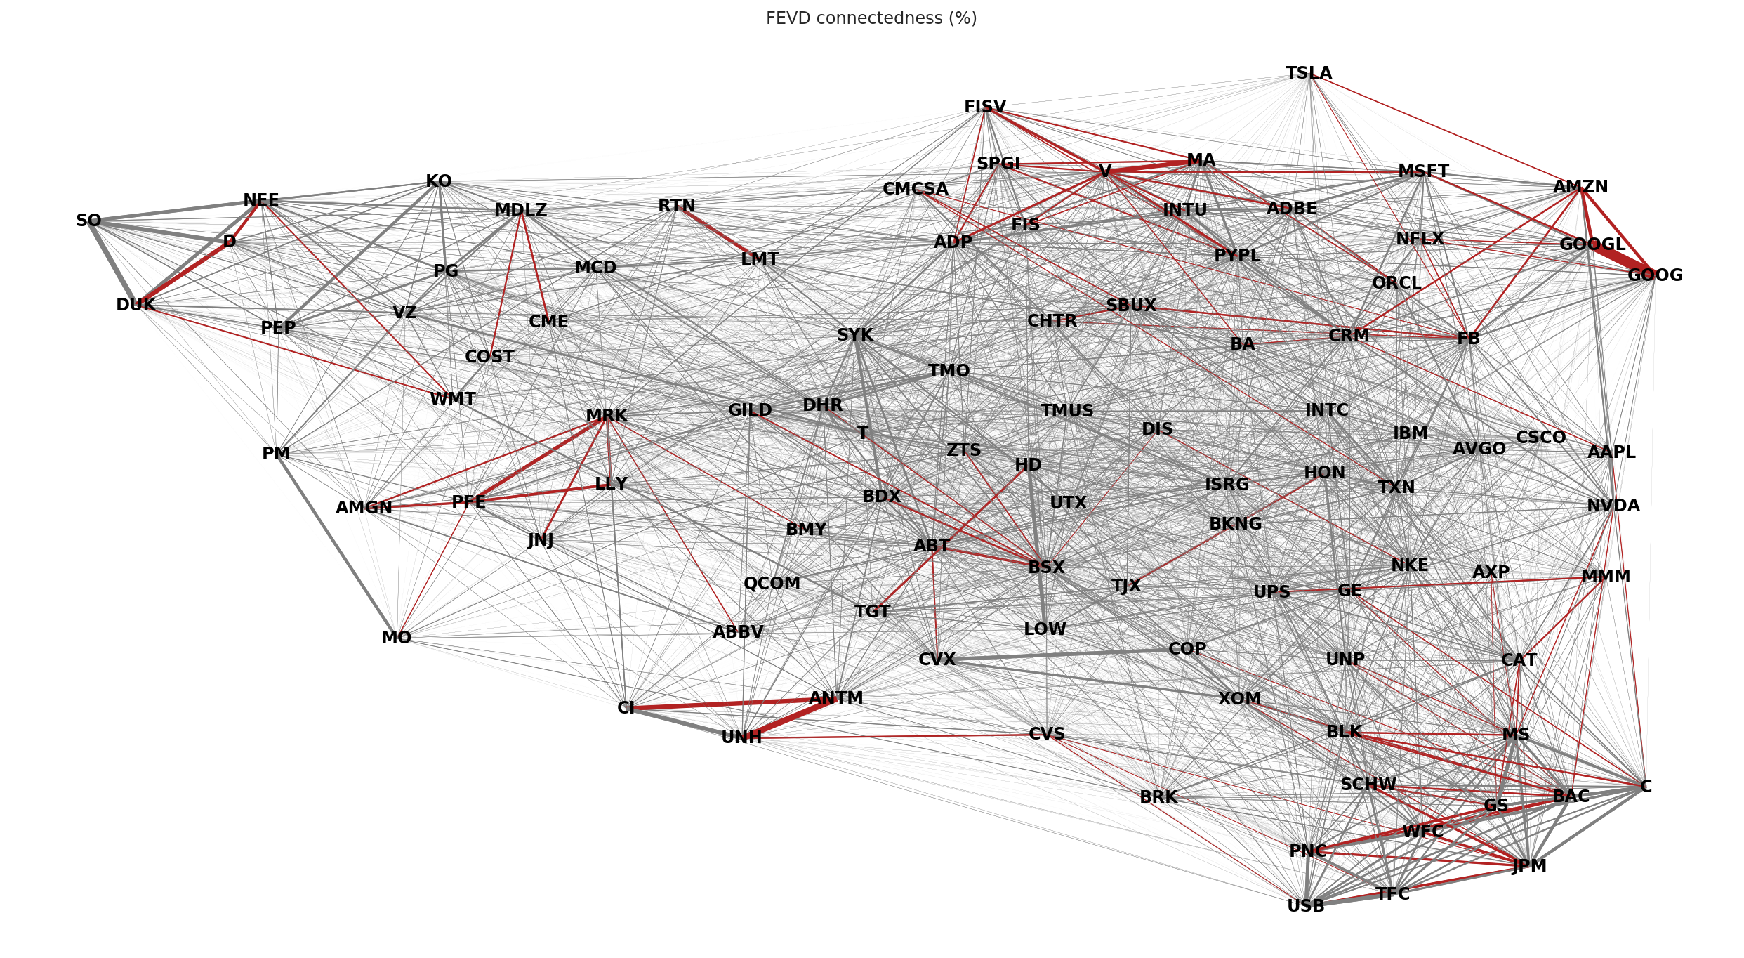
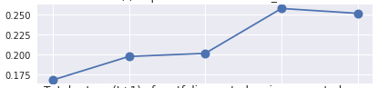
I. Data Source
II. Sampling
III. Factor Model
IV. Total Variance Decomposition
V. VAR Estimation
VI. Covariance Estimation
VII. Network construction
VIII. Empirical Analysis
Data flow
fundamentals
intraday variance
raw data
Idiosyncratic variances
daily returns
VAR residuals
Network data
CRSP daily
Compustat fundamentals
100 largest
betas
Covariance estimates
VAR coefficients
CAPM timeseries regressions (OLS)
Forecast error variance decomposition
Adaptive Elastic Net
12-fold cross-validation
Forecast assessment
Asset pricing tests
Estimate flow
Adaptive threshold estimation
12-fold cross-validation
Stock-Watson decomposition
Data sampling
Preprocessing
Network Estimation
Analysis

Slide 2
I. Data Source
II. Sampling
III. Factor Model
IV. Total Variance Decomposition
V. VAR Estimation
VI. Covariance Estimation
VII. Network construction
VIII. Empirical Analysis
prices & fundamentals
D A T A
intraday variance
raw data
daily returns
idiosyncratic variances
VAR residuals
P R O C E S S I N G
CRSP daily
Compustat fundamentals
100 largest by market capitalisation
CAPM timeseries regressions (OLS)
Stock-Watson decomposition
Adaptive Elastic Net
12-fold cross-validation
Adaptive threshold estimation
12-fold cross-validation
Forecast error variance decomposition
Forecast assessment
Asset pricing tests
betas
VAR coefficients
covariance estimates
network estimates
E S T I M A T E S
Data sampling
Preprocessing
Network Estimation
Analysis

Slide 3
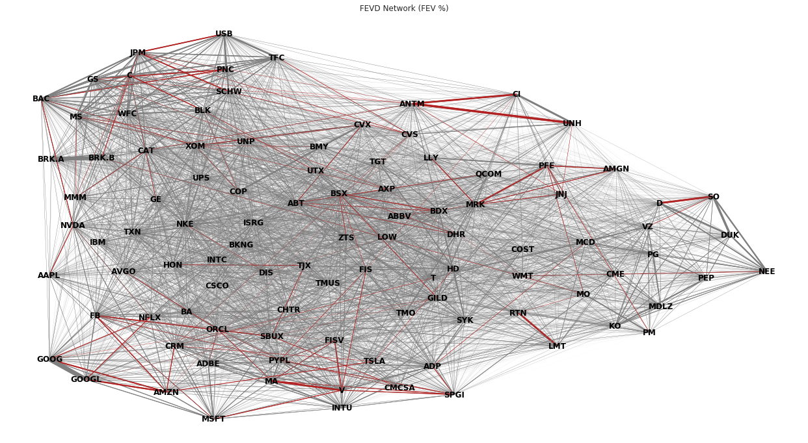
I. Data Source
II. Sampling
III. Factor Model
IV. Total Variance Decomposition
V. VAR Estimation
VI. Covariance Estimation
VII. Network construction
VIII. Empirical Analysis
prices & fundamentals
D A T A
intraday variance
raw data
daily returns
idiosyncratic variances
VAR residuals
P R O C E S S I N G
CRSP daily
Compustat fundamentals
100 largest by market capitalisation
CAPM timeseries regressions (OLS)
Stock-Watson decomposition
Log transform
Fill missing
Adaptive Elastic Net estimation
12-fold cross-validation
Graphical Lasso estimation
12-fold cross-validation
Forecast error variance decomposition
Forecast assessment
Asset pricing tests
betas
VAR coefficients
covariance estimates
network estimates
E S T I M A T E S
Data sampling
Preprocessing
Network Estimation
Analysis

Slide 4
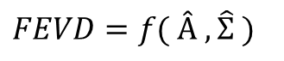
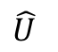
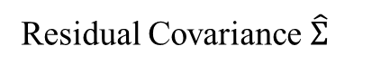
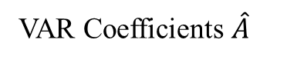
$$FEVD=f( Â , \hat{Σ} )$$
VAR Coefficients $\hat{A}$
Residual Covariance $\hat{Σ}$
The construction of FEVD networks requires estimation of VAR coefficients and the Residual Covariance matrix as inputs
VAR coefficient estimation:
OLS
Covariance matrix estimation:
Sample Covariance
$$\hat{U}$$
Bridge regressions
(adaptive) LASSO
Ridge regression
(adaptive) Elastic net
Economically motivated regularization of long-run dependencies
Adaptive Thresholding
Soft-thresholding
LASSO thresholding
Ledoit and Wolf shrinkage estimator
Graphical LASSO
Regularization methods enable estimation when impaired by high-dimensionality

Slide 5
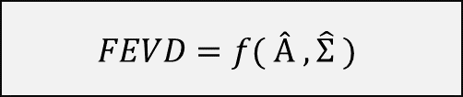
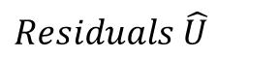
$$FEVD=f( Â , \hat{Σ} )$$
VAR Coefficients $\hat{A}$
Residual Covariance $\hat{Σ}$
The construction of FEVD networks requires estimation of VAR coefficients and the Residual Covariance matrix as inputs
VAR coefficient estimation:
OLS
Covariance matrix estimation:
Sample Covariance
$$Residuals \hat{U}$$
Bridge regressions
(adaptive) LASSO
Ridge regression
(adaptive) Elastic net
Economically motivated regularization of long-run dependencies
Adaptive Thresholding
Soft-thresholding
LASSO thresholding
Ledoit and Wolf shrinkage estimator
Graphical LASSO
Regularize when impaired by high-dimensionality

